Slide 1
Compassion Based
Approaches for
Pain Management
Chris Penlington
Clinical Psychologist
chris.penlington@ncl.ac.uk
Notes:
FIXED Image / Presentation title slide.
Insert title and sub-deck as required to start your presentation.
`1234567890-=qwertyuiop[]asdfghjkl;’#\zxcvbnm,./
¬!”£$%^&*()_+QWERTYUIOP{}ASDFGHJKL:@~|ZXCVBNM<>?

Slide 2
Compassion Focused Therapy and related approaches
Pain Science
Application to Pain Management
Notes:
FIXED image section divider slide.
Edit copy as required.

Slide 3

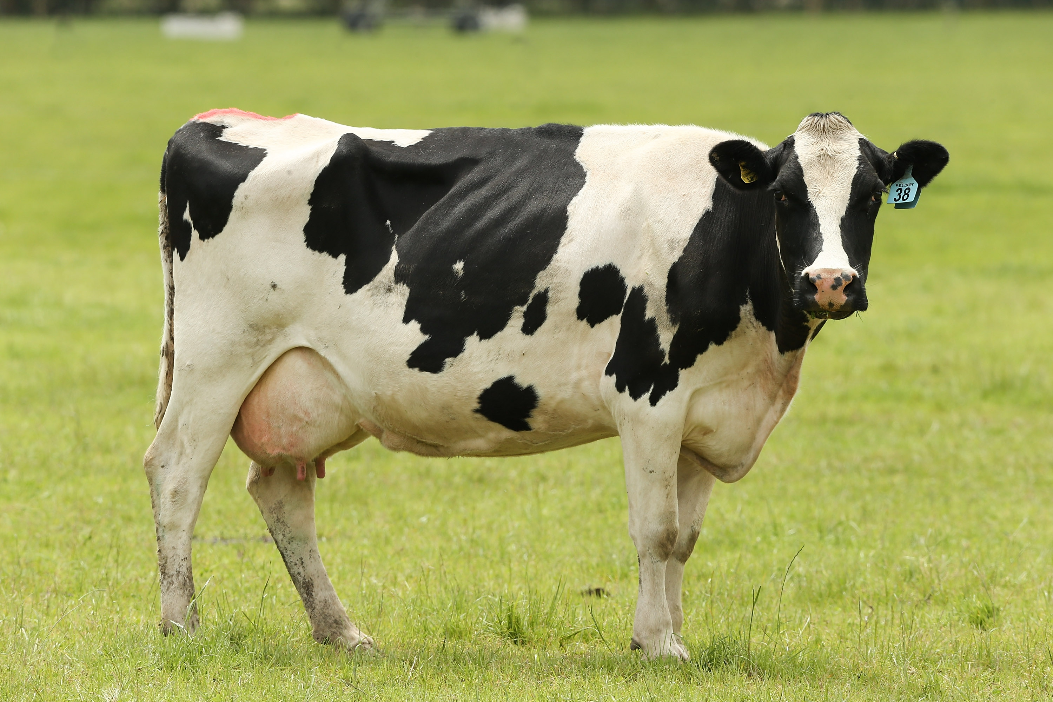

Compassion Based Approaches for Pain Management
CFT introduced by Paul Gilbert as a therapy for people with depression and high levels of shame and self-criticism.
Evolutionary approach seeks to normalise and bring understanding to habitual patterns and so reduce self-blame, shame and self-criticism for behaviours / patterns that we find difficult to understand or justify.
We just find ourselves here
In circumstances we can neither choose nor control
With tricky human minds
That evolved for very different circumstances
Notes:
BLANK SLIDE
To duplicate slide, select copy on tool bar and then duplicate on drop down menu.

Slide 4
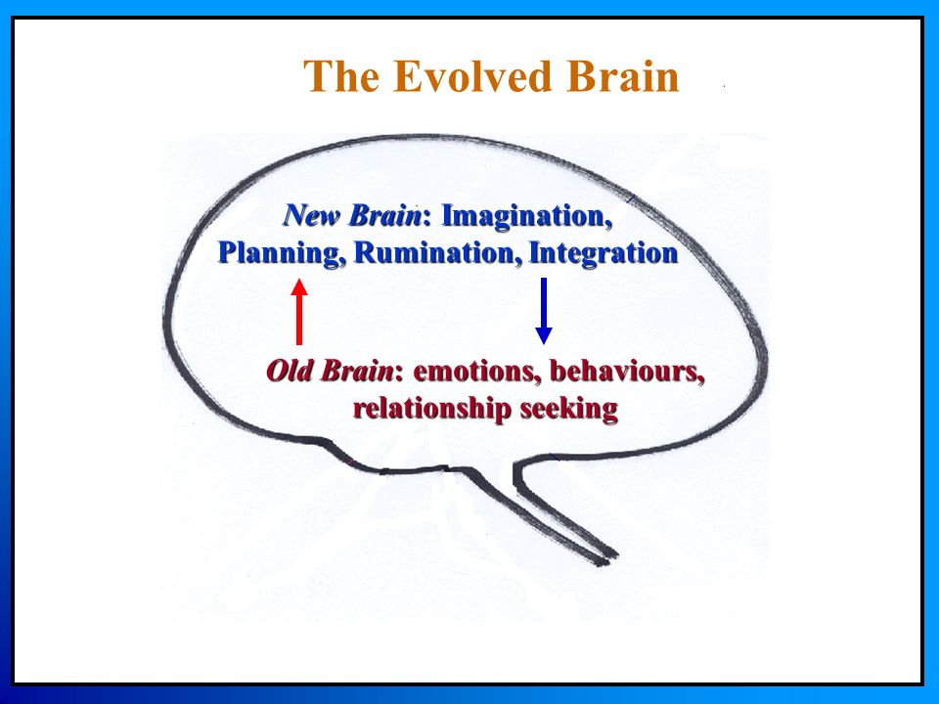
Compassion Based Approaches for Pain Management
Human brains are ‘tricky’
Powerful basic motivations include safety, dominance and resources.
Human capacities for self awareness and thinking interact with these basic motivations.
Our tricky human minds predispose us to tricky patterns of behaviour which are shaped by old / new brain competencies in modern environments.
CFT helps us to understand that these behaviours are not our fault, but that we do have a choice (and responsibility) to build our awareness of them and look to change them if they are destructive.
Old brain motivations. New brain competencies
Notes:
BLANK SLIDE
To duplicate slide, select copy on tool bar and then duplicate on drop down menu.

Slide 5
Compassion Based Approaches for Pain Management
avoid, ignore or suppress
Drains energy
Threat
With self-awareness, our own behaviours, thoughts and feelings are remembered and available to be judged.
This can become a source of constant threat.
unhealthy consequences of avoidance strategies
awareness
Notes:
BLANK SLIDE
To duplicate slide, select copy on tool bar and then duplicate on drop down menu.

Slide 6

Compassion Based Approaches for Pain Management
Self-Compassion Break by Kristen Neff
This is a moment of suffering
Suffering is a part of life
May I give myself the kindness that I need.
Mindfulness
Common Humanity
Self-Kindness
Notes:
BLANK SLIDE
To duplicate slide, select copy on tool bar and then duplicate on drop down menu.

Slide 7
Compassion Based Approaches for Pain Management
Three circles model of emotion
Safety vs safeness
Notes:
BLANK SLIDE
To duplicate slide, select copy on tool bar and then duplicate on drop down menu.

Slide 8
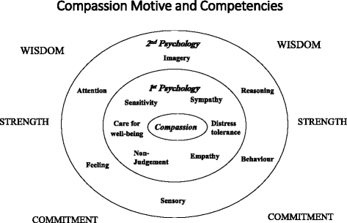
Compassion Based Approaches for Pain Management
Aim is to approach our most difficult experiences with compassion and understanding.
Reduce shame, stigma and other causes of experiential avoidance.
Enable gradual exposure to difficult feelings.
Integration and acceptance of previously intolerable aspects of experience.
Notes:
BLANK SLIDE
To duplicate slide, select copy on tool bar and then duplicate on drop down menu.

Slide 9
Compassion Focused Therapy and related approaches
Pain Science
Notes:
FIXED image section divider slide.
Edit copy as required.

Slide 10
Compassion Based Approaches for Pain Management: Pain Science
Melzack and Wall: Gate control theory, neuromatrix
Wall: function of pain
Moseley and Butler: Explain Pain
Mechanisms: Pain can be produced in the absence of damage, damage is not always accompanied by pain.
Purpose: Most accurate description of the purpose of pain is a warning or call to attention. This can refer to physical, psychological or social situations.
(eg Eisenberger and Lieberman)
Notes:
BLANK SLIDE
To duplicate slide, select copy on tool bar and then duplicate on drop down menu.

Slide 11
Compassion Based Approaches for Pain Management: Pain Science
https://youtu.be/goK2rivxTqQ
Notes:
BLANK SLIDE
To duplicate slide, select copy on tool bar and then duplicate on drop down menu.

Slide 12
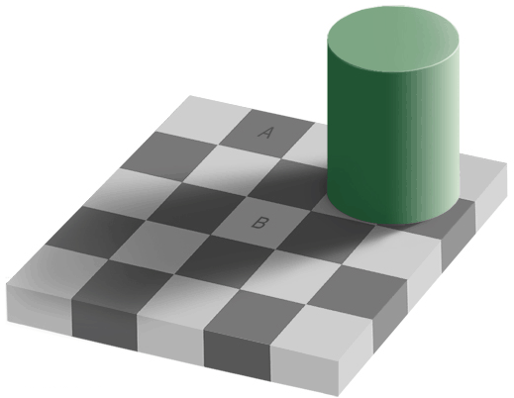
Pain Science: Processing visual information
Notes:
Sometimes I will also use a visual illusion to illustrate how our brains are involved in processing our perceptual experiences and how these are affected by a wide range of experiences.
At first when we look at the picture most people see square A as darker than square B. However when we change the background from the original pattern to plain white, we now see that both squares are in fact the same shade.
This tells us something about how our automatic information processing works. At first, the brain takes into account all information including the background, recognises a checked board and makes the assumption that the squares will form a regular pattern. An inference is also made that the cylinder would cast a shadow accounting for some squares seeming to be darker. We are unaware of none of this, as it all happens below the threshold of our awareness. We simply ‘see’ the picture in a certain way. However, the illusion enables us to understand that we are not ‘seeing’ a simple representation of what is in front of us, but rather experiencing an image created by the brain on the basis of the processing that has taken place.
The same can be true of pain. The brain takes into account many different pieces of information and background factors and comes to a conclusion based on what seems to be the most likely scenario. The finished experience that we are presented with (pain) is an output of the brain as a result of the automatic processing that has taken place.

Slide 13
Compassion Based Approaches for Pain Management
Pain
What it is | What it is not
A warning / call to attention | A reliable indication of tissue damage, disease or injury
An alarm | An accurate description
Responsive to context | Fixed
Influenced by a complex range of biological, psychological and social factors. | Simple
Notes:
BLANK SLIDE
To duplicate slide, select copy on tool bar and then duplicate on drop down menu.

Slide 14
Compassion Focused Therapy and related approaches
Application of CFT to Pain Management
Notes:
FIXED image section divider slide.
Edit copy as required.

Slide 15
Compassion Based Approaches for Pain Management
What?
Why?
A warning or alarm, indicating potential harm and the need for attention.
Not a reliable description of damage.
Protection from threat.
Includes biological, psychological and social factors.
Pain
Plausible explanation and rationale for treatment.
CFT non-blaming explanations for behavioural and thought patterns.
Bringing self compassion to challenging internal experiences.
Reduce experiential avoidance.
Self-soothing and compassionate exercises.
Reduce threat from psychological and social factors.
Build capacity for feeling safe (activation of soothing system).
Management
Notes:
BLANK SLIDE
To duplicate slide, select copy on tool bar and then duplicate on drop down menu.

Slide 16
Compassion Based Approaches for Pain Management: Rationale
Response to pain and fatigue:
Physical symptoms have wide-ranging impact and require a highly flexible response both to the symptoms themselves and their impact.
Setbacks can be experienced as highly threatening and might trigger avoidance / self-criticism / shame.
Social context for people with pain and fatigue can be highly stigmatizing.
All of the above factors could lead to symptoms increasingly being experienced as highly threatening, in turn triggering further threat responses that could increase symptoms.
Threat responses also lead to narrowing of focus and therefore missing out on opportunities to still do what is important.
Notes:
BLANK SLIDE
To duplicate slide, select copy on tool bar and then duplicate on drop down menu.

Slide 17
Compassion Based Approaches for Pain Management: Rationale
Impact of Lifelong habits:
Many people feel unsafe being on contact with some aspects of internal experience.
This can lead to long-term habits of avoidance and suppression.
Over time this can exhaust energy supplies and reduce resilience to adverse events which may trigger symptoms such as pain and fatigue.
Notes:
BLANK SLIDE
To duplicate slide, select copy on tool bar and then duplicate on drop down menu.

Slide 18
Compassion Based Approaches for Pain Management
Notes:
BLANK SLIDE
To duplicate slide, select copy on tool bar and then duplicate on drop down menu.

Slide 19
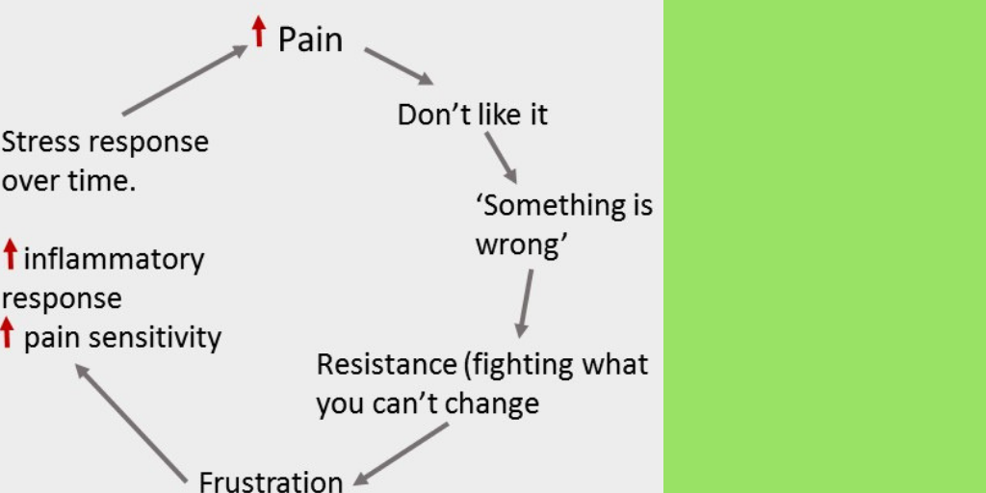
Compassion Based Approaches for Pain Management
This is hard
How can I help myself with this right now?
Soothing / grounding
Common humanity
Notes:
BLANK SLIDE
To duplicate slide, select copy on tool bar and then duplicate on drop down menu.

Slide 20
Compassion Based Approaches for Pain Management
Plausible Meaning
Compassion based methods
Interrupt patterns that cause long-term unhelpful impact
Strengthen resources that support long-term positive health
Notes:
BLANK SLIDE
To duplicate slide, select copy on tool bar and then duplicate on drop down menu.

Slide 21
Compassion Based Approaches for Pain Management
Example 1:
Patient with pain and fatigue.
Initially regularly overdoing things.
Closely followed advice about pacing and relaxation.
Lots of self-criticism and self-blame when symptoms continued.
Very concerned about being a burden, not wanting to put people out, being able to make a contribution.
Notes:
BLANK SLIDE
To duplicate slide, select copy on tool bar and then duplicate on drop down menu.

Slide 22
Compassion Based Approaches for Pain Management
Example 2:
Patient with pain and fatigue.
Has tried everything.
This pain is real. Pain management techniques won’t help.
Notes:
BLANK SLIDE
To duplicate slide, select copy on tool bar and then duplicate on drop down menu.

Slide 23
Compassion Based Approaches for Pain Management
Example 3:
Patient with post-surgical pain and altered sensation.
Doesn’t feel like me.
I always was able to cope so well with everything. Now I’m a mess.
Ashamed to be seen.
People can make insensitive comments.
Notes:
BLANK SLIDE
To duplicate slide, select copy on tool bar and then duplicate on drop down menu.

